Slide 1
Advertising Positioning
Feng Fan, Zhang Yue, and Curtis Kelsey

Slide 2
Overview

Slide 3
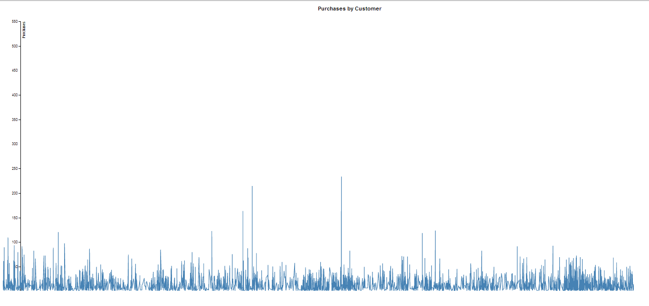
Purchases by Customer

Slide 4
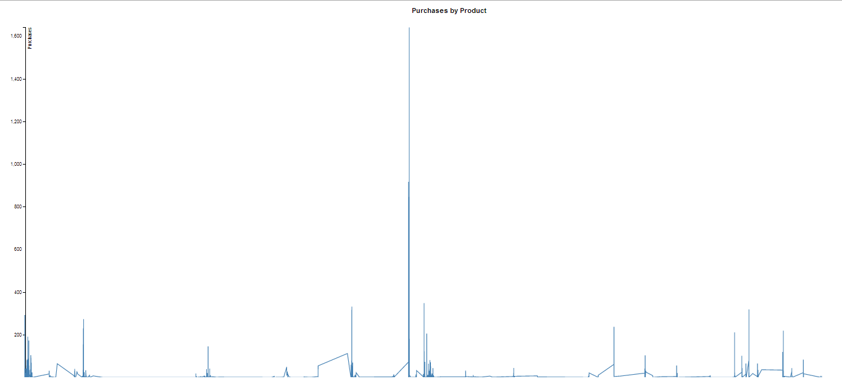
Purchases by Product

Slide 5
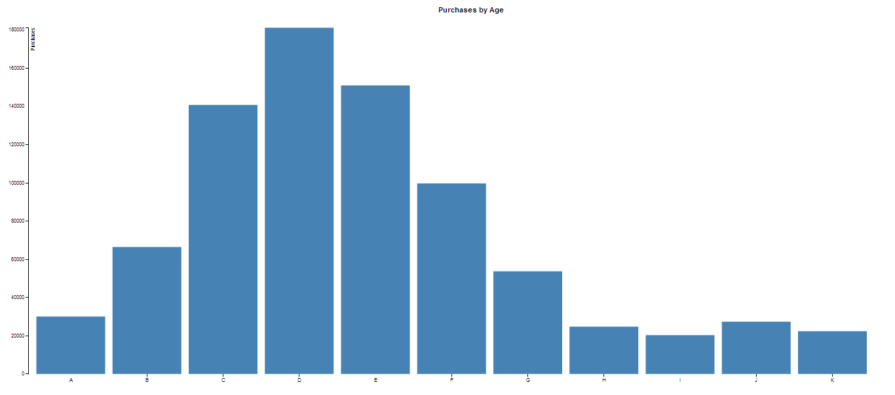
Purchases by Age

Slide 6
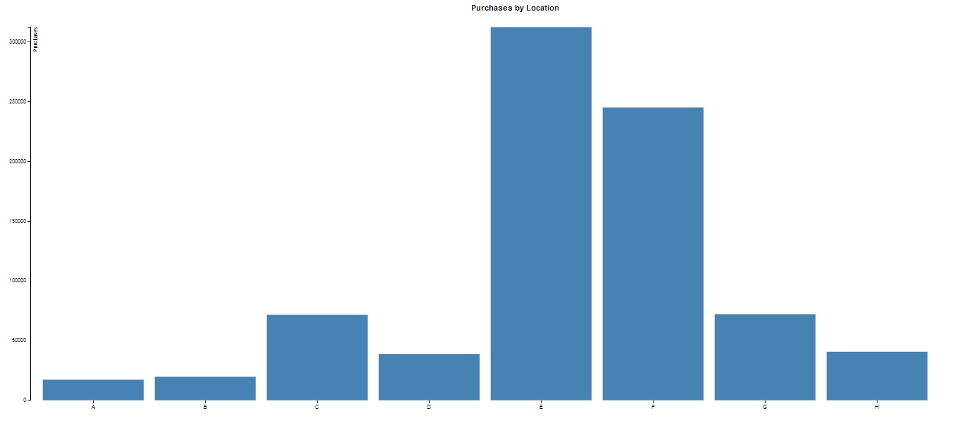
Purchases by Location

Slide 7
Summary

Slide 8
References
TaFeng data set, Artificial Intelligence for Investigating Anti-cancer solutions, Institute of Information Science, Academia Sinica, Taiwan (http://aiia.iis.sinica.edu.tw/index.php?option=com_docman&task=cat_view&gid=34&dir=DESC&order=date&limit=5&limitstart=5)

Slide 9
Questions?

